Slide 1
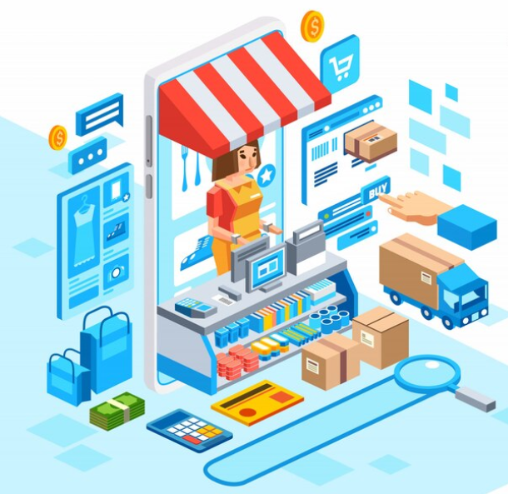
Retail Billing System
Presented By: Man Desai

Slide 2
The Problem
Human errors in manual billing process.
Time-consuming for longer bills.
Difficulty tracking and managing inventory levels.
Limited scalability of manual systems poses challenges during business growth.
Lack of business insights in manual system.

Slide 3
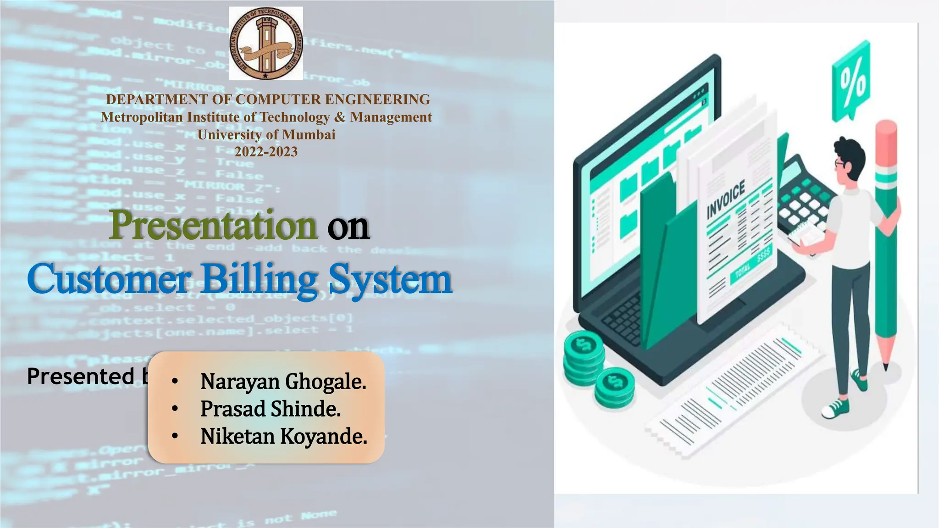
Objective
To develop an efficient and user-friendly retail billing system for enhanced business operations.

Slide 4
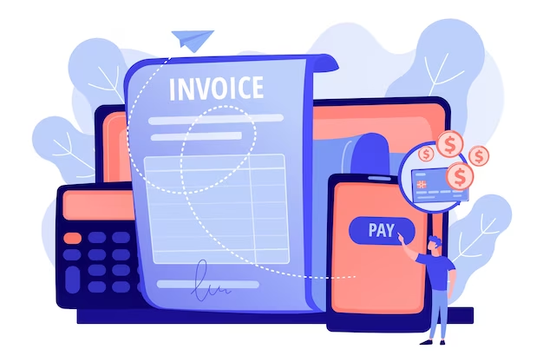
System Architecture
User Interface Module
Search Module
Billing Module
Email Module

Slide 5
Functionalities
Enter customer details
Allows shopkeeper to input essential customer information into the system.
Calculate Total
Sum up the prices of the selected products.
Generate & View Bill
Create a detailed bill with itemized information
Include the taxes and final total.
Save Bill
Store bills securely for future reference.
Easy access to transaction history.

Slide 6
Functionalities
Search Bills
Efficient search functionality
Retrieve bills based on date, customer, or product
Email Bill
Seamless integration with email services
Print Bill
Print bills for physical records
Support for various printers and formats

Slide 7
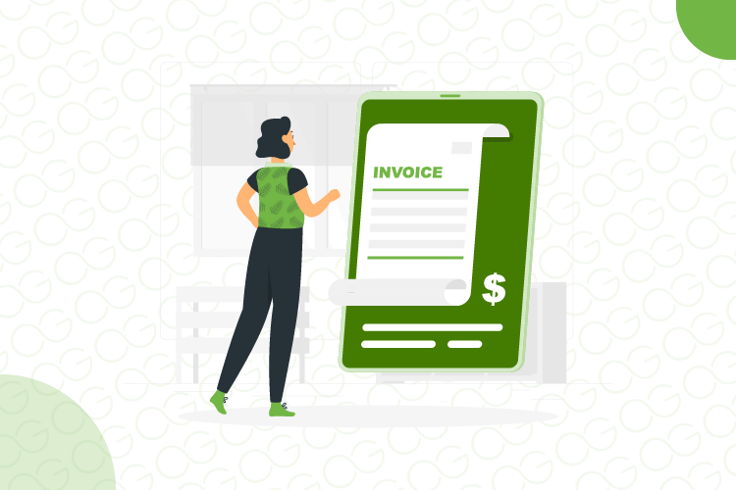
Results

Slide 8
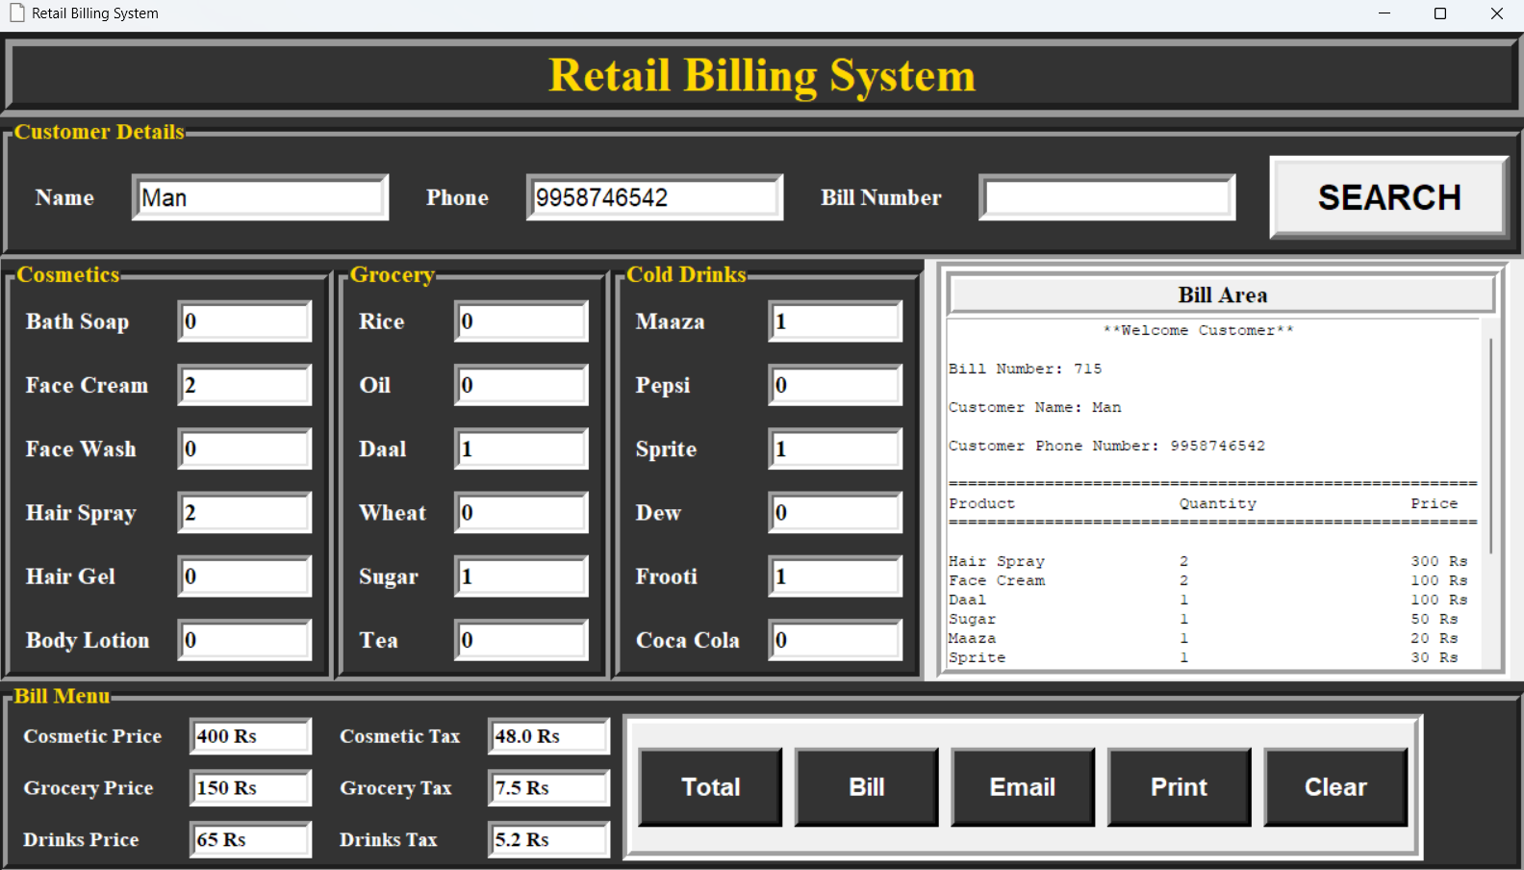

Slide 9
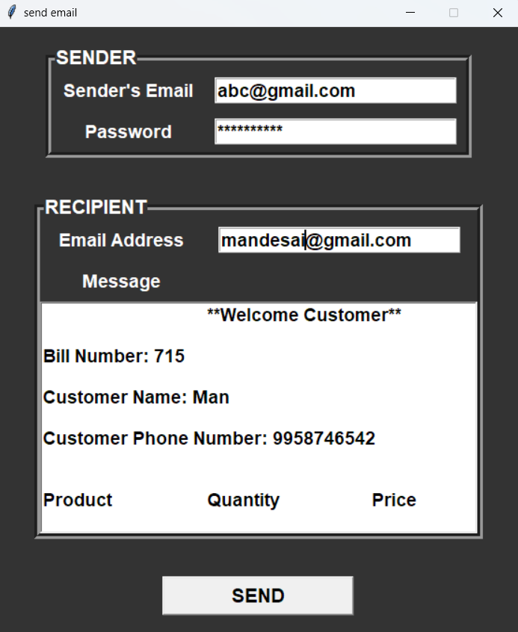
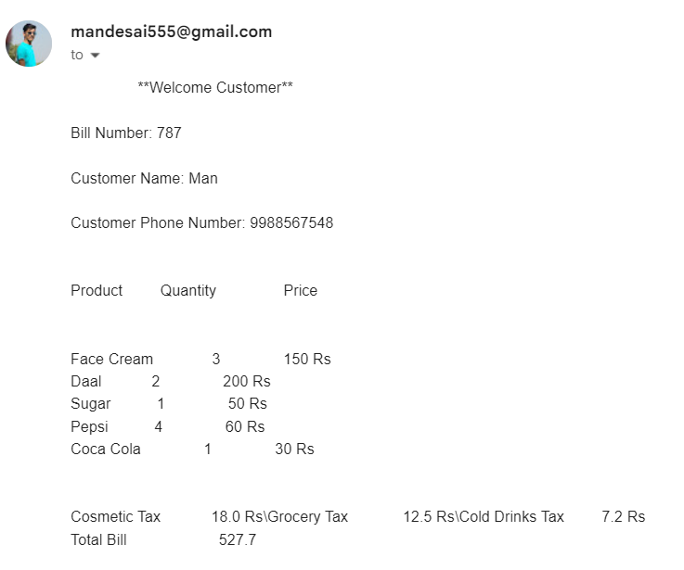

Slide 10
Conclusion
In conclusion, the retail billing system provides an innovative and efficient solution for managing retail transactions. It provides a user-friendly interface that can enable small shop owners to efficiently manage their transactions. It also provides an email functionality which enables the shop owners to connect with their customers via email.

Slide 11
Future Work
Database integration to collect the customer and sales data.
The data collected from retail billing system can be used to provide valuable insights to the shopkeepers on their business.

Slide 12
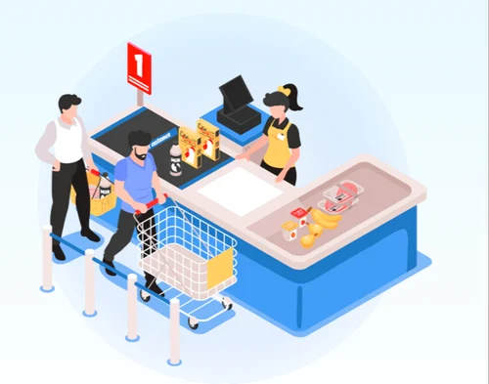
Thank You

